Slide 1
BYU Admissions Case
Session 2.3
Notes:
http://www.youtube.com/watch?v=Qvv84VxpPgo
https://en.wikipedia.org/wiki/Gratz_v._Bollinger -affirmative action case Michigan undergrad point system
https://www.byu.edu/numbers (demographic numbers for BYU--as an availability heuristic example, also to show the need for diversity)

Slide 2
BYU Admissions Case
Class Activity
In your teams, come to consensus about whether to admit these candidates as if you were the BYU admissions committee.
You can admit all, some, or none.

Slide 3

Discussion Question:
How does if feel to make big decisions that affect people’s lives?
Notes:
Any decision dealing with human capital
HR—staffing, promotions, bonuses.

Slide 4
Discussion Question:
How does this case relate to real-world business decisions?
Notes:
Any decision dealing with human capital
HR—staffing, promotions, bonuses.

Slide 5
Diversity vs. Affirmative Action
  What is the difference?
  Hint: Gratz v. Bollinger (2003)

Slide 6
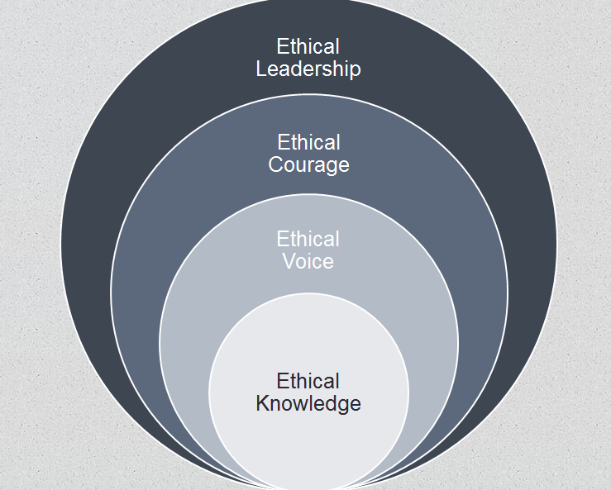
BYU Admissions Case
Themes
Value-Based Decision-Making
  Articulating values is difficult
  “Objective” Rules vs. General Principles

Slide 7

BYU Admissions Case
Articulating What’s Right
Rules?
Expectations?
Agreements?
Principles/Values?
Notes:
Start based on rules, but then these may not fully capture what you think is right, may not be as hard and fast as you thought

Slide 8
Free Solo Case
You are the considering filming David Honnold free solo attempt of El Capitan, a 3,000 foot cliff face. This would be one of most dangerous feats captured on a camera.
1. What are the ethical issues surrounding this decision?
2. What would a utilitarian do? A deontologist?
3. Would the benefits outweigh the drawbacks? Why?

Slide 9
Learning Objectives
Know:
Understand the implications and challenges of ethical decision-making in groups, along the themes of:
  Values-based decision-making
  Groupthink and groupshift
  The subjectiveness of thresholds
Understand the difference between diversity and affirmative action.
Feel:
A desire to grow in your ability to influence others respectfully and effectiveness in group decision-making situations.
(Conversely) A desire to be receptive and appropriately let the insights/ideas of others refine your perspective/decisions.
Do:
Identify the values being invoked on both sides of the major social issues of our day.
Discuss this case with a friend and how being at BYU has influenced your values and perspectives.

Slide 10
Key Take-Aways
Understand why arguing a decision based on values is challenging.
Awareness and articulation
Assumption of value symmetry
Values shape direction but not magnitude or specificity
Understand why we like to cling to “objective” rules, thresh holds, cutoffs, or standards, but that they actually represent subjective values and are rare in the business world.
Understand the difference between diversity and affirmative action.

